Slide 1








Option #1
Build Your
Resume Online
Using Azure
Static Web Apps
Thomas Gauvin
Ricardo Prins

Slide 2
Requirements
Visual Studio Code – https://code.visualstudio.com/Download
GitHub account – https://github.com
Git - https://git-scm.com/downloads
Azure account – https://azure.microsoft.com

Slide 3
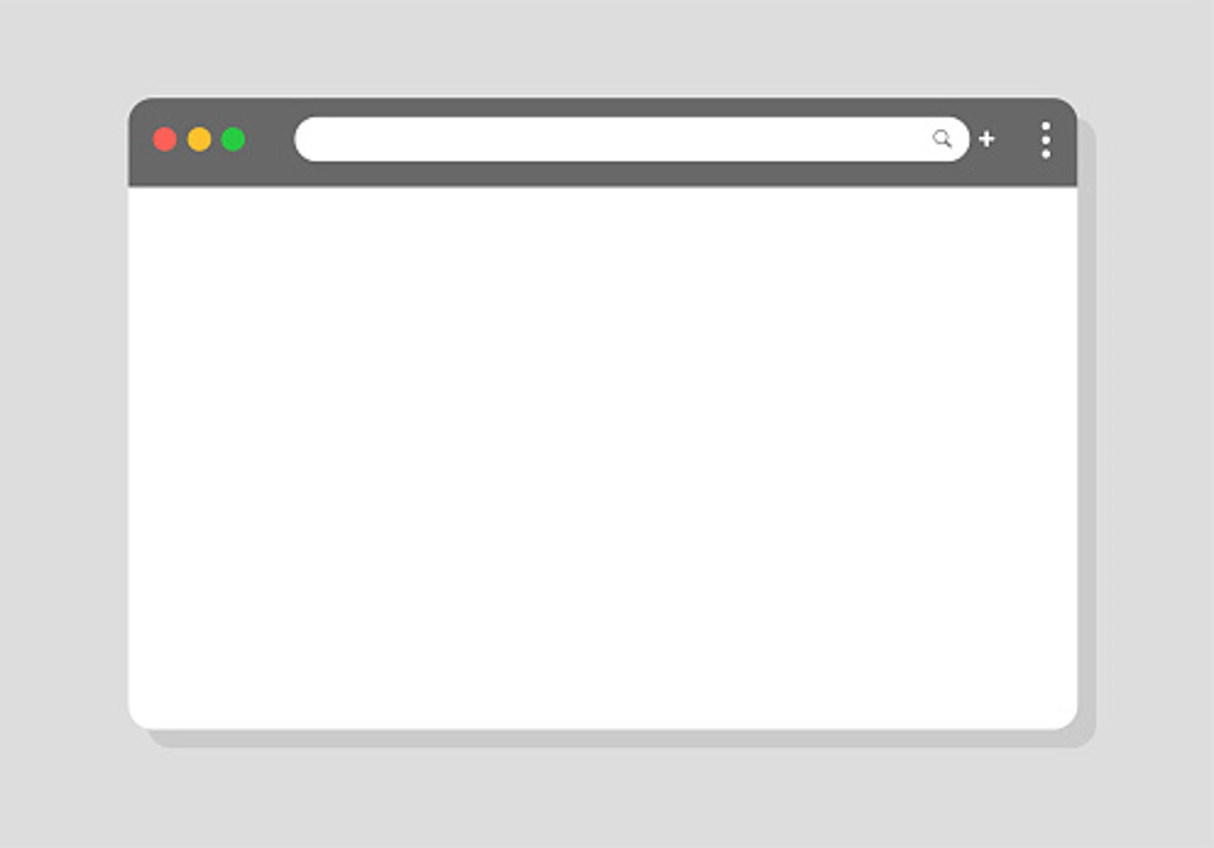
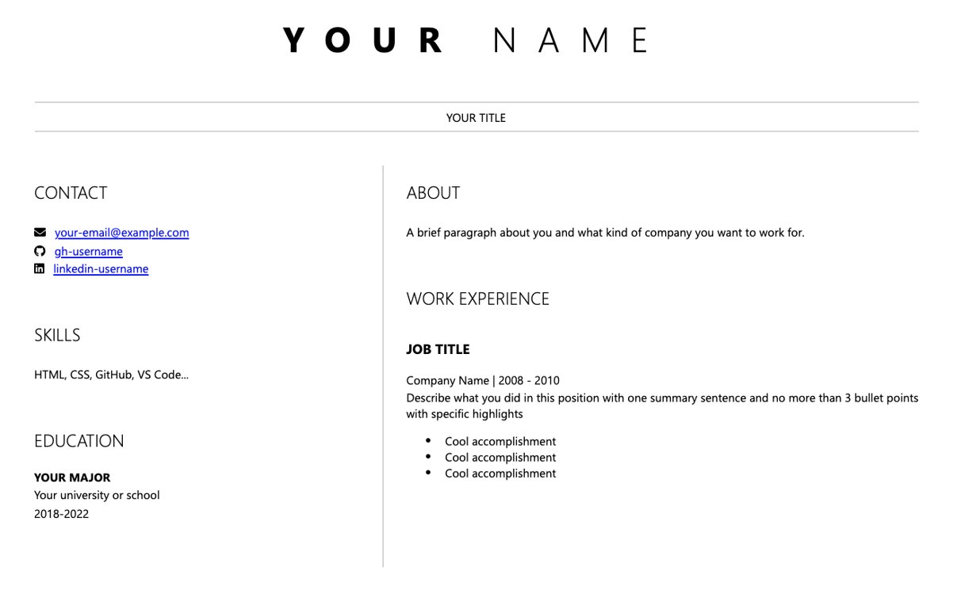

Slide 4
Steps for this presentation
Getting started
HTML: first steps
Adding elements
CSS
Pushing to GitHub and Deploying into Azure
Questions

Slide 5
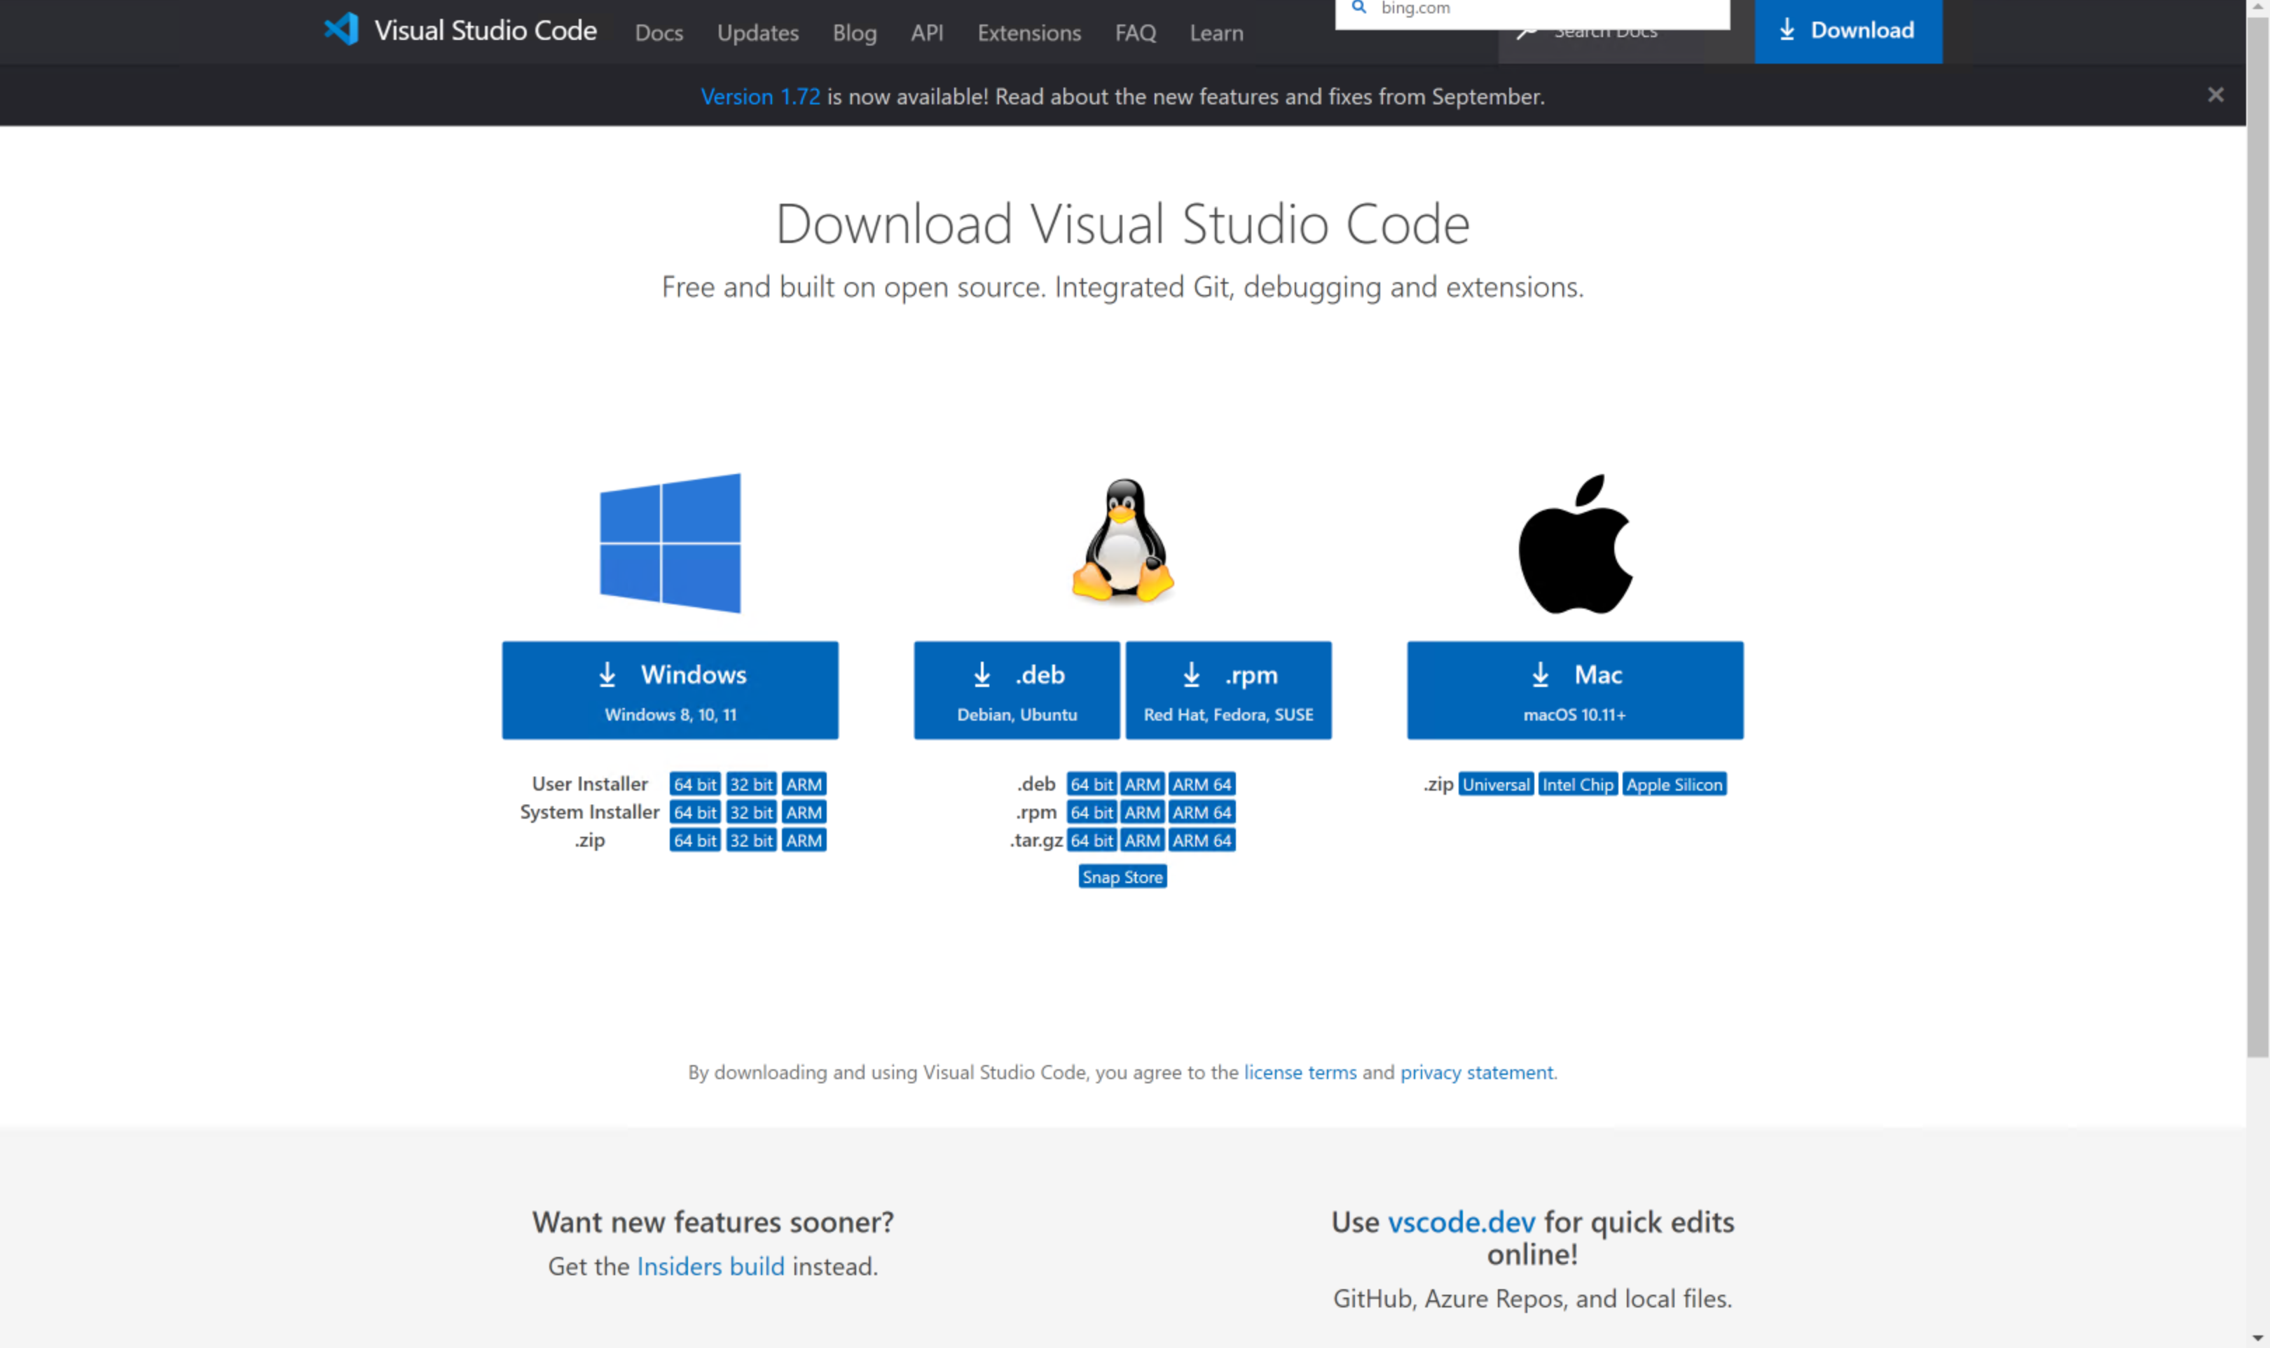
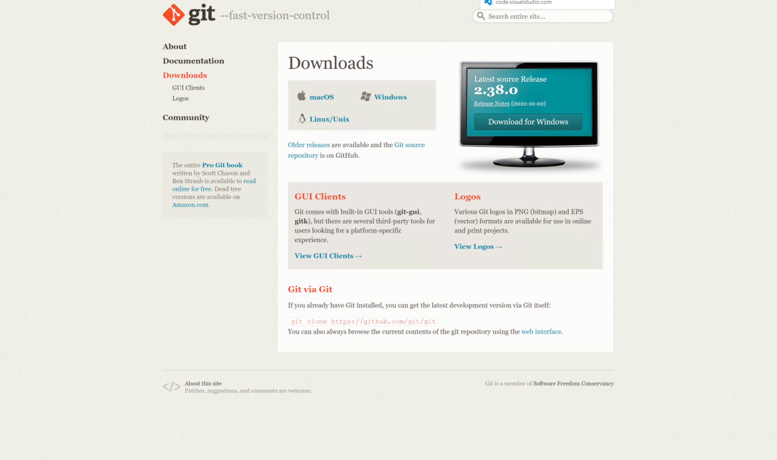
Getting started
Download and install Visual Studio Code
(https://code.visualstudio.com)
Download and install Git
(https://git-scm.com)

Slide 6
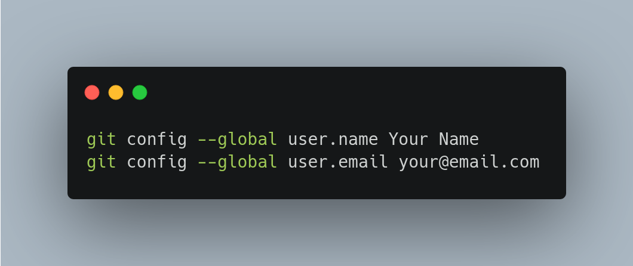
Getting started

Slide 7
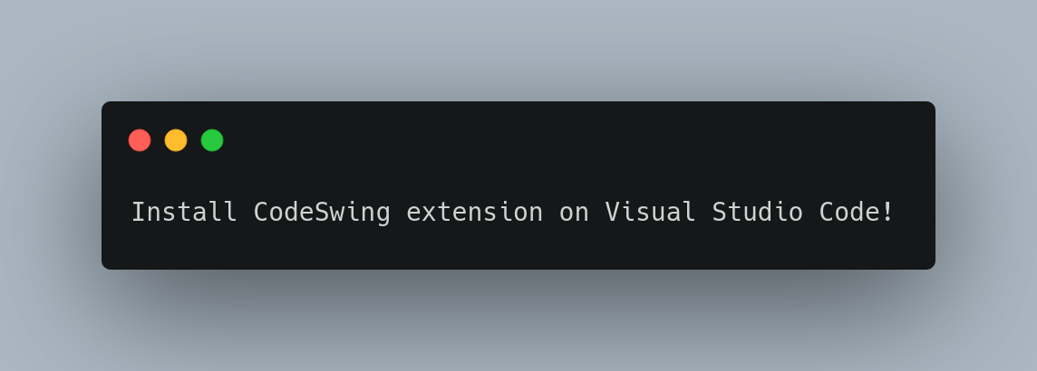
Getting started

Slide 8
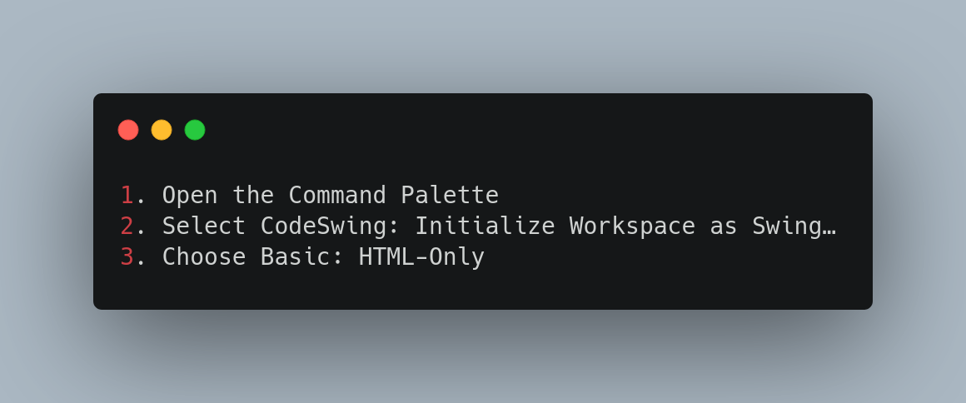
Getting started

Slide 9
HTML
html
head
body
link
title
header
main
h1
article
article

Slide 10
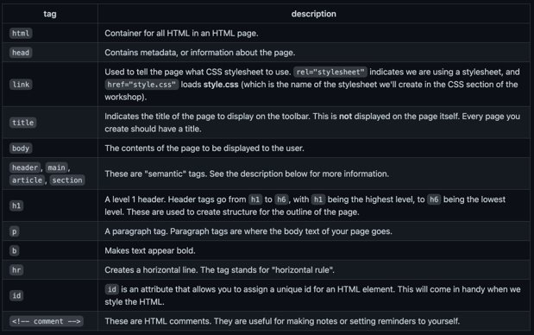
HTML

Slide 11
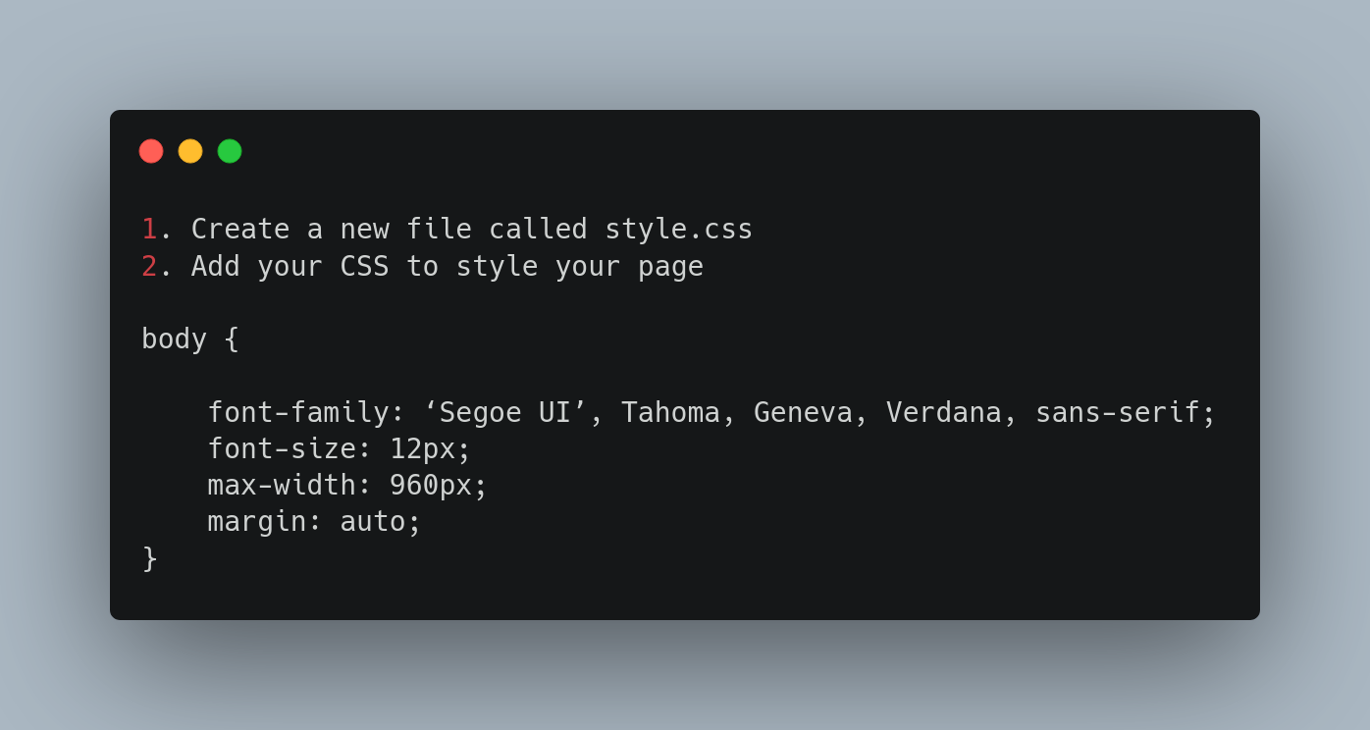
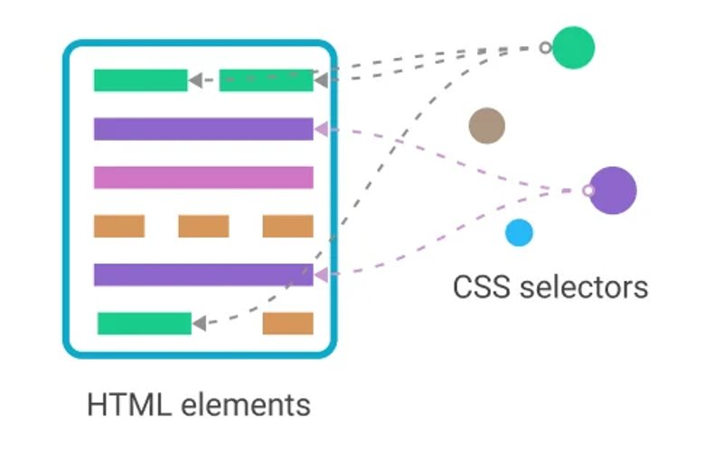
CSS

Slide 12
CSS
Additional resources:
- Get started viewing and changing CSS
- HTML5 and CSS3 Fundamentals: Development for Absolute Beginners

Slide 13
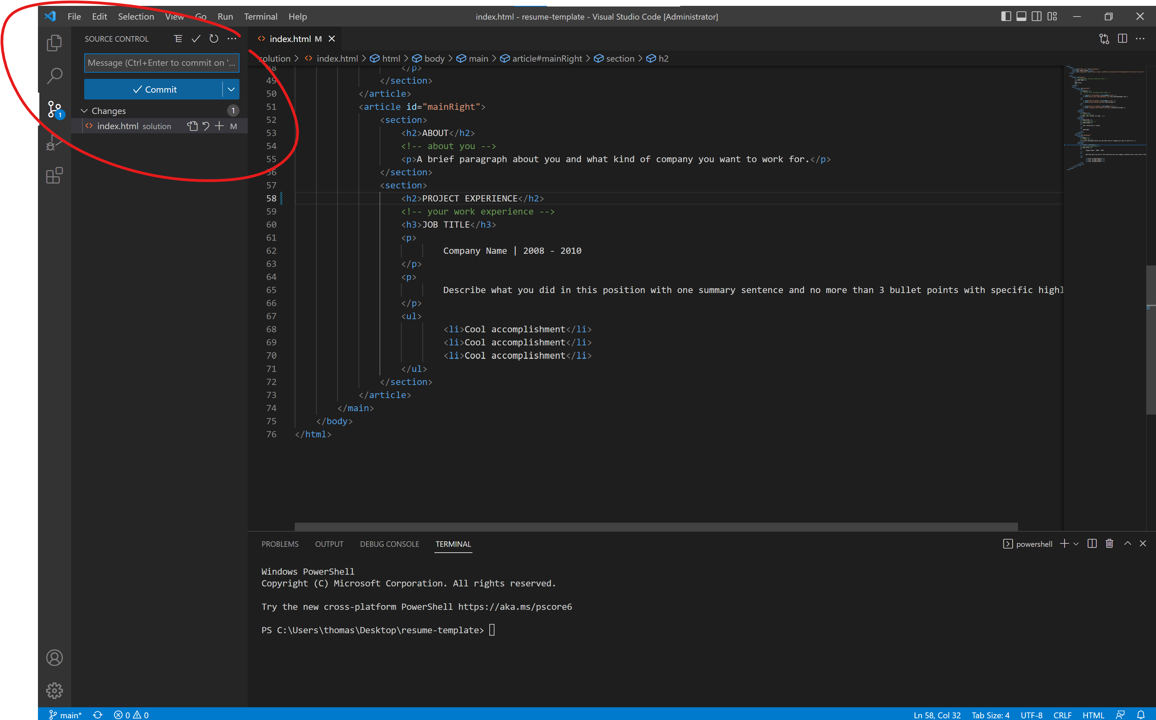
Pushing to GitHub

Slide 14
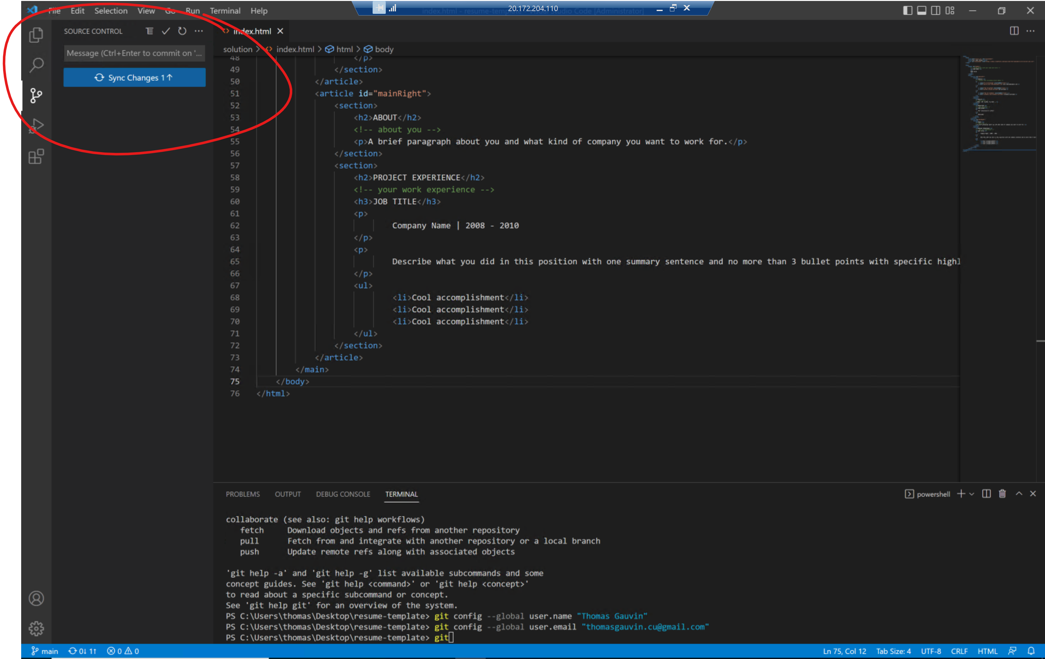
Pushing to GitHub

Slide 15
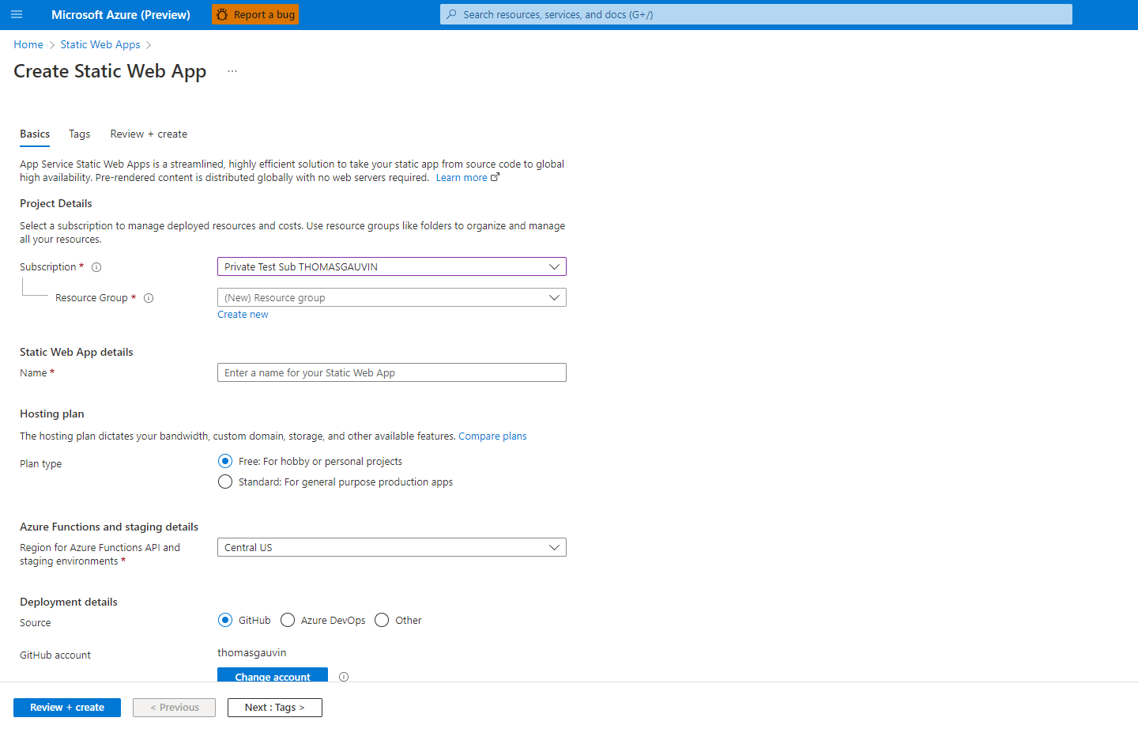
Create Static Web App with Portal

Slide 16
Thank you!

